Slide 1

Causal and statistical inference:
an introduction
XAI hackathon series
David Pinho
30-11-2023

Slide 2
Content
Difference between causal and statistical inference
Causal inference
Assignment #1
Present results #1
Statistical inference
Assignment #2
Present results #2
Discussion: applicability in industry

Slide 3

Causal and statistical inference
The difference between them
And why it matters

Slide 4
Prediction vs causal inference vs statistical inference
Sales will be 10% higher because we spent more money on TV ads (we are 90% sure)
How confident are you in that explanation?
What will happen?
Why will it happen?

Slide 5
Inference vs prediction
Prediction
Estimate the expected value of an output conditional on a set of inputs (data) and model (parameters)
Inference
Estimate the expected value (or any other quantity) of a parameter given your inputs and outputs
In practice
Causal inference: can we draw conclusions from that quantity?
Statistical inference: how sure are we in those conclusions?
p(y | X, θ)
g(θ | X, y)
Note:
p -> probability
g -> quantity of interest (probability, variance, loss, etc.)
y -> outcome
X -> inputs
Θ -> parameters

Slide 6
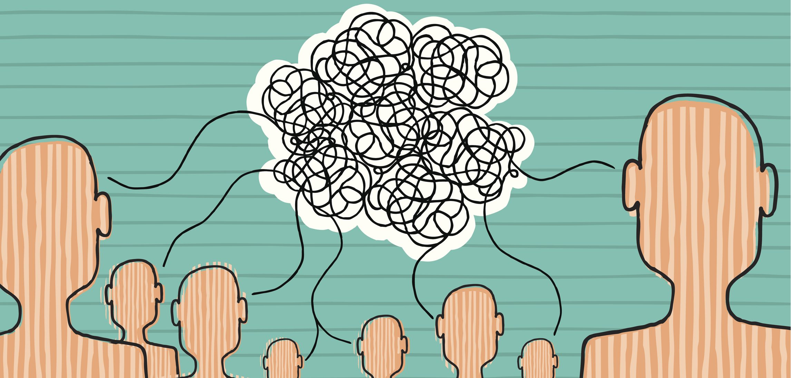
A few common misconceptions about inference

Slide 7
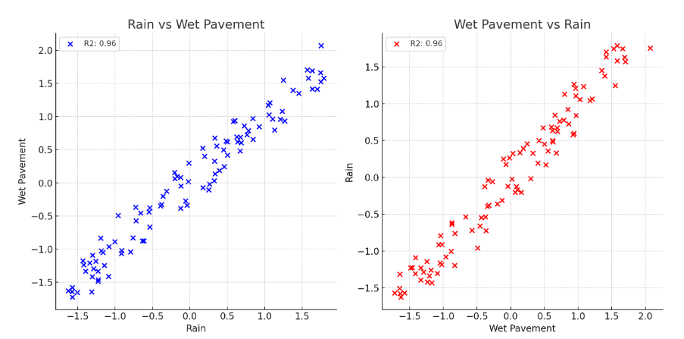
“Let data speak for itself”
Inference is seen similarly to interpretability (explaining causes to “dumb humans”)
Can’t infer causes/direction from data alone
Inferring causes from data always requires assumptions
The meaning behind the data matters
That’s the only way to disentangle cause from effect

Slide 8

“Causal inference is useless, A/b testing is the way”
Randomization is seen as the holy grail
Randomization is better, but only if you have a very clean experiment
You can’t have contamination between samples
Time-varying effects will bite you
You can’t always randomize (or fully randomize)
Most data isn’t “random”
There are barriers to randomization
Examples: ethics, regulations, extra costs, physical constraints
You need to know what and how to randomize
Causal inference is needed for that

Slide 9
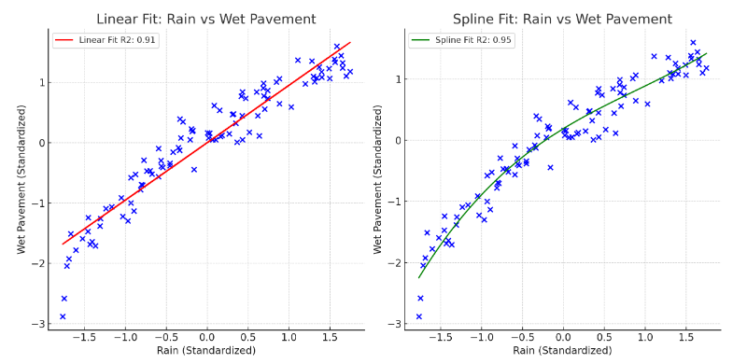
“I can’t trust the explanation of a model that can’t predict well”
Prediction is seen as the ultimate barometer of model quality
Yes, predictions always matter, but it’s not that simple
They only matter insofar as your causal assumptions are correct
And sometimes extra predictive power won’t lead to different decisions

Slide 10
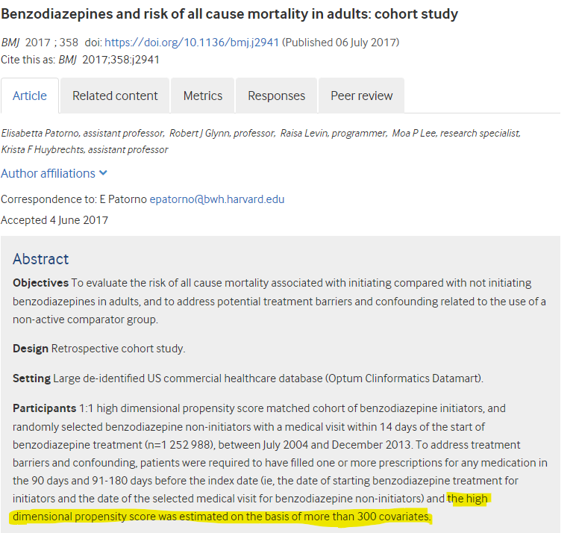
“control for as many factors as possible [by including all inputs]”
Models are seen as tools that have the power to magically randomize non-random experiments
Don’t add inputs to your model blindly
When you “control”/adjust for a cause, you can create a bias
But not including that input can also fail to account for biases
It depends!
Overfitting is still an issue

Slide 11
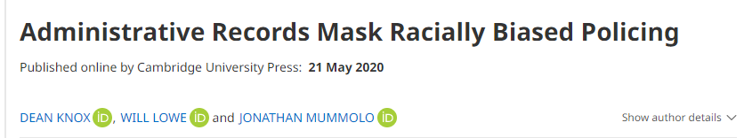
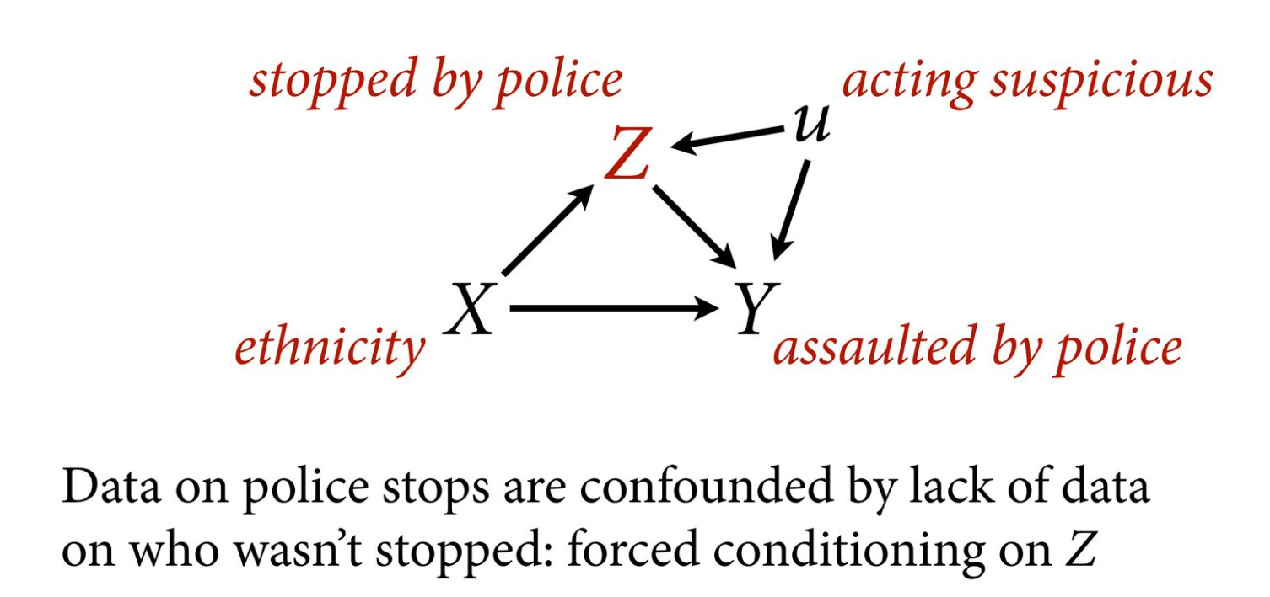
Example: adding variables leads to worse
Source: https://speakerdeck.com/rmcelreath/statistical-rethinking-2022-lecture-10?slide=18
Notes:
Example from this lecture: https://speakerdeck.com/rmcelreath/statistical-rethinking-2022-lecture-10?slide=24

Slide 12
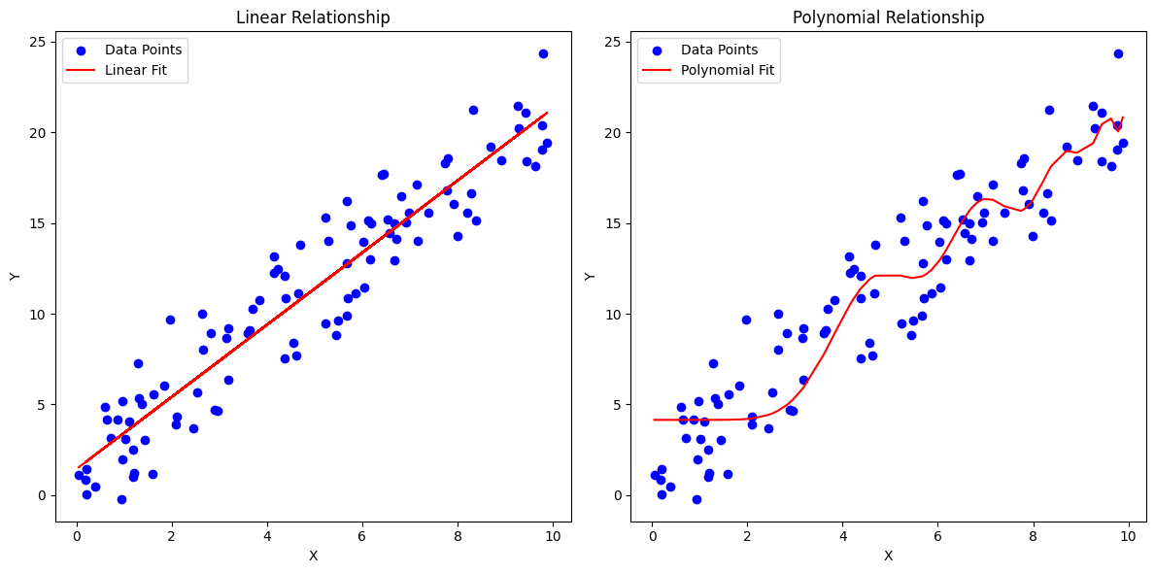
“High variance doesn’t matter, give me low bias”
Models are seen as tools that have the power to magically randomize non-random experiments
Used as a justification to use linear regression everywhere
Take it to an extreme and it’s a justification for overfitting everywhere
It’s possible to have lower bias AND lower variance
Example: non-linear relationship modeled with linear regression vs spline with regularization; or when capture add heterogenous effects because you can include more variables
In practice you don’t know where error comes from (bias or variance)
Occam’s Razor (principle of parsimony) doesn’t tell you about tradeoffs
So, use prediction performance as your anchor

Slide 13
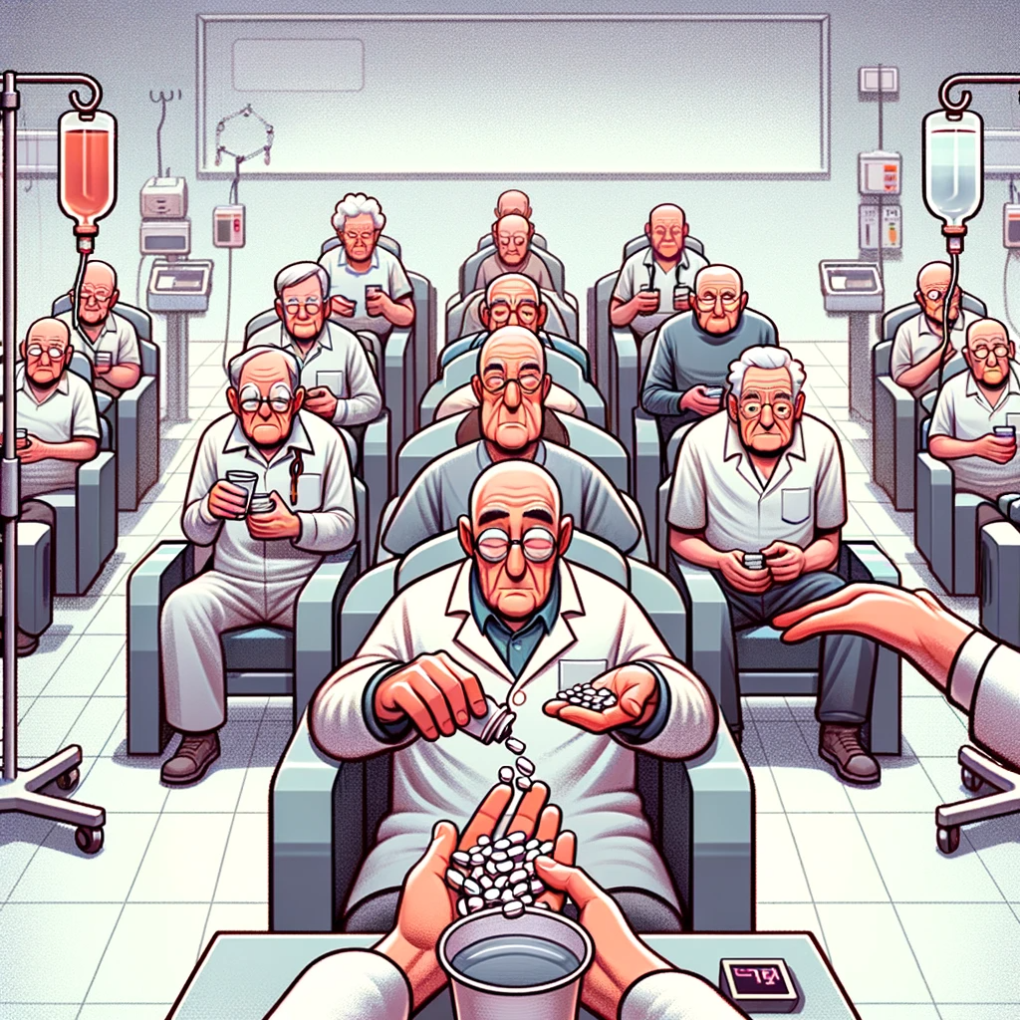
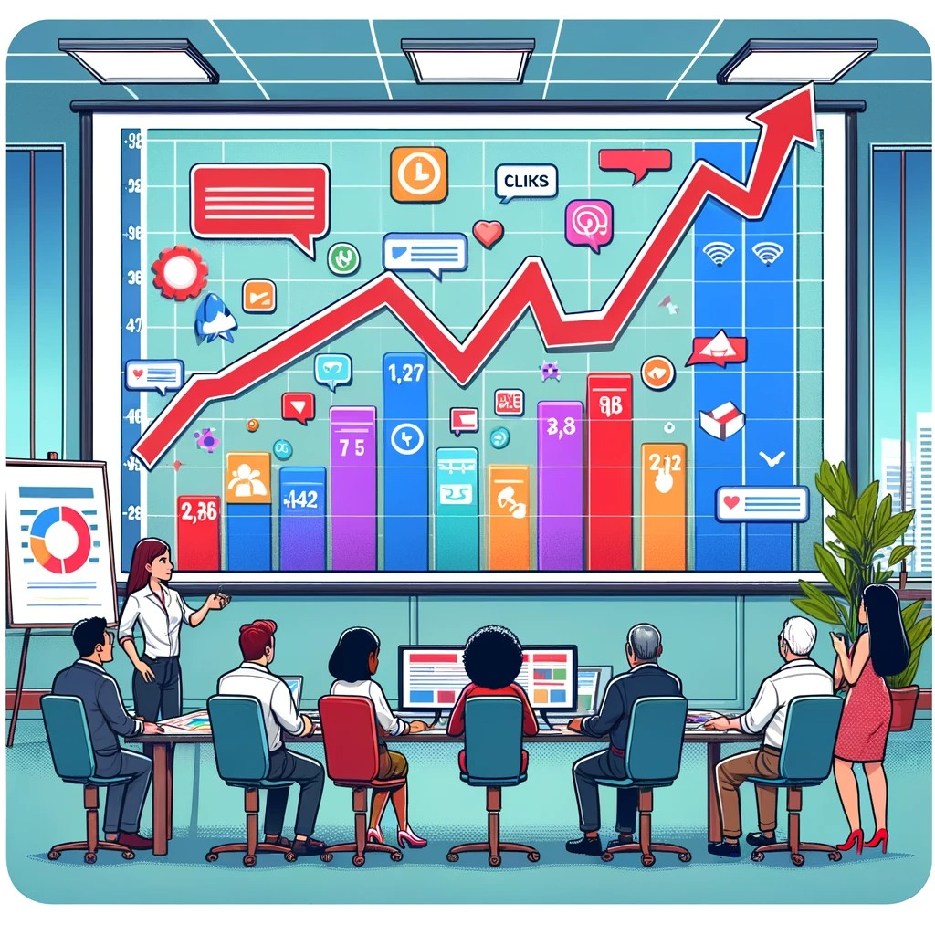
“You can only do inference if you have more than 30 observations”
Models are seen as tools that have the power to magically randomize non-random experiments
Some types of models/tests (but not all) have
There’s no hard cutoff or minimum
It depends on noise (unexplained variance) and effect size
More noise? Larger the sample size
Larger effect size? Smaller sample size
Prior knowledge influences these things, not just the data
Medical treatment in patients with identical outcome vs CTR in marketing campaign

Slide 14
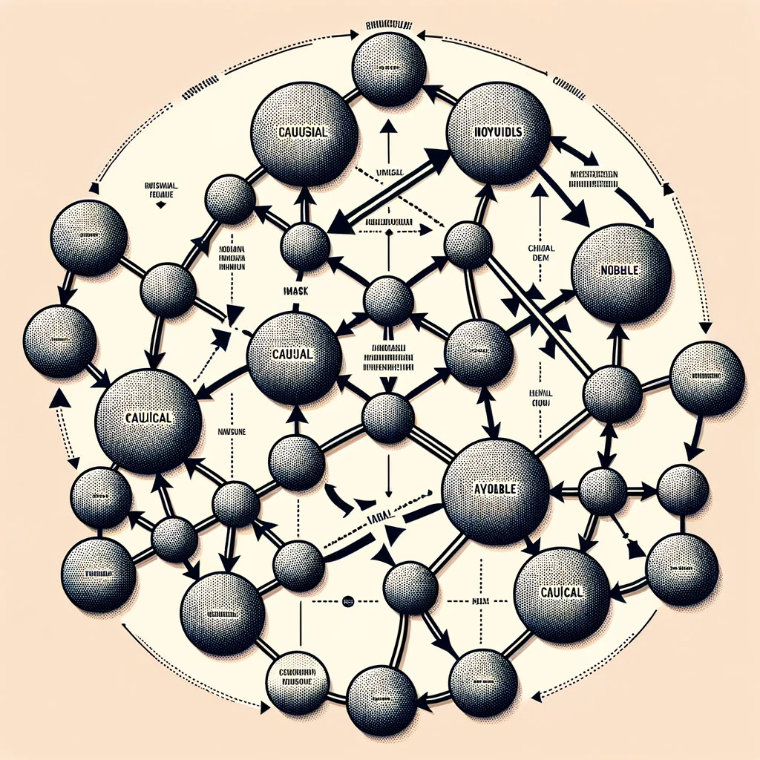
Causal inference
An introduction

Slide 15
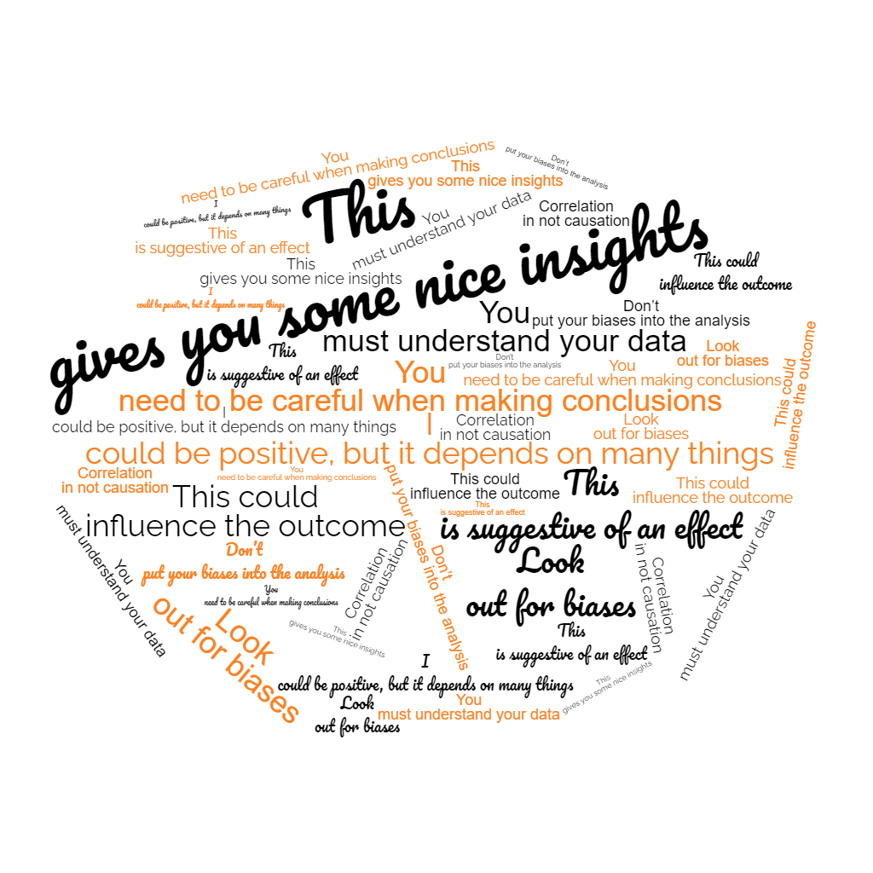
Avoid weasel words
Platitudes that allow you to CYA

Slide 16
Frameworks over platitudes
(Good) frameworks gives you a shared language
And (good) frameworks allow you to make falsifiable statements
Workflow that we’re aiming for:
Come up with a set of models that can plausibly answer your question
Fit them to the data (or check if their implications are true)
Give more credence to the model with better performance

Slide 17
Causality 101
“Smoking causes cancer”
You can think about causality in 2 (equivalent) ways:
Counterfactuals: how things would have been different if something had changed (past)
Interventions: how the outcome will change if we apply an intervention (future)
You can represent causal relationships in many ways (e.g., structural causal models)
We are going to use Directed Acyclic Graphs because
Don’t worry about specifying the mathematical form of the model (implementation details)
Focus on the domain knowledge you have
Don’t worry about feedback loops (those happen over time, requires time-series or equilibrium models)

Slide 18
Every DAG is built from these 4 elementary relationships
The fork, “confounder variable”
The pipe, “mediator”
The collider, “collider bias”
The descendant, often a “proxy”
Nodes/variables can be observed or hidden
“Condition on [input]” means putting that input in a model

Slide 19
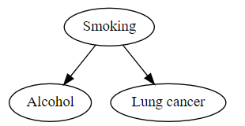
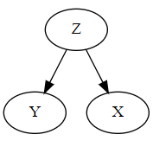
The Fork
Confounder variable
X is associated with Y but doesn’t cause it
You need to condition on Z for X and Y to be independent

Slide 20
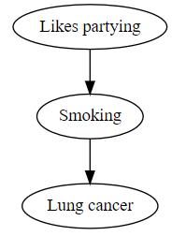
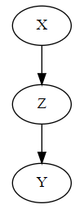
The Pipe
Mediator variable
X is associated with Y but doesn’t cause it
You need to condition on Z for X and Y to be independent

Slide 21
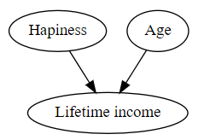
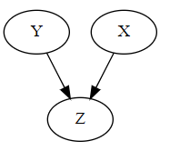
The collider
Collider bias
Young person could happy or not happy
Holding “Lifetime income” fixed:
Old person with high income = average happiness
Young person with high income = must have high happiness
X is independent from Y
If you condition on Z, X and Y will be associated, even if they don’t cause each other

Slide 22
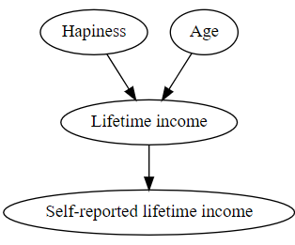
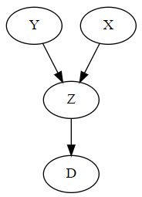
The descendant
Proxy variable
D is the descendant
X is independent from Y
If you condition on Z and/or D, X and Y will be associated, even if they don’t cause each other
Conditioning on D is like partially conditioning on Z unless they’re fully correlated

Slide 23
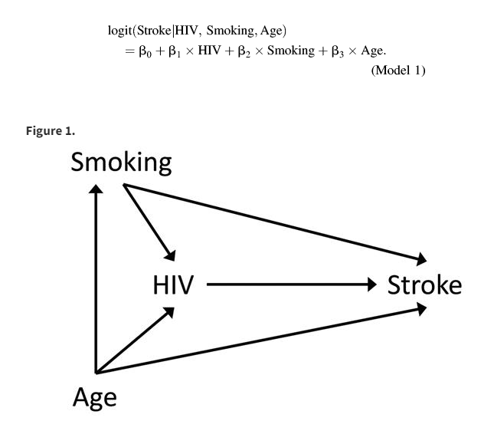
Different questions, different models
Example from the “The Table 2 Fallacy: Presenting and Interpreting Confounder and Modifier Coefficients” paper
Fallacy: all parameters in your model have the same meaning

Slide 24

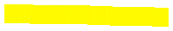
Different questions, different models
Example from the “The Table 2 Fallacy: Presenting and Interpreting Confounder and Modifier Coefficients” paper
“What is the effect of HIV on having a stroke?”
You can say:
“We want the direct effect of HIV” (yellow)
Or “we want to know the effect of HIV, everything else equal”
Putting Smoking and Age in the model blocks the paths
Beta 3 gives you the relationship in yellow

Slide 25


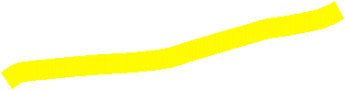

Different questions, different models
Example from the “The Table 2 Fallacy: Presenting and Interpreting Confounder and Modifier Coefficients” paper
“If they get older by 20 years, how does that affect the probability of having a stroke?”
We want the total effect of age
logit(Stroke | Age) = B0 + B1 x Age

Slide 26
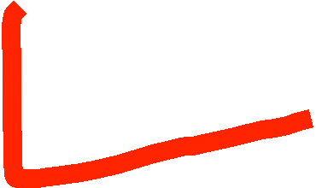

Different questions, different models
Example from the “The Table 2 Fallacy: Presenting and Interpreting Confounder and Modifier Coefficients” paper
“If they are smokers, how does that affect the probability of having a stroke?”
We want the total effect of smoking
If you fit this model:
logit(Stroke | Age) = B0 + B1 x Smoking
There’s an issue: smoking is confounded with age
(direct effect)
(indirect effect)

Slide 27
Different questions, different models
Example from the “The Table 2 Fallacy: Presenting and Interpreting Confounder and Modifier Coefficients” paper
“If they are smokers, how does that affect the probability of having a stroke?”
We want the total effect of smoking
If you fit this model:
logit(Stroke | Age) = B0 + B1 x Smoking + B2 x age

Slide 28
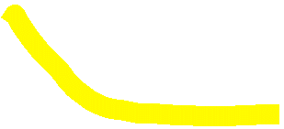
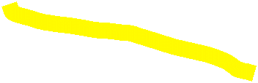
What randomized experiments do
Example from the “The Table 2 Fallacy: Presenting and Interpreting Confounder and Modifier Coefficients” paper
Take a few people for a study.
Pick a few at random, force some to smoke.
Force the others not to smoke.
Now we can get the total effect of smoking on having a stroke with just:
logit(Stroke | Age) = B0 + B1 x Smoking

Slide 29
Interpretation for the full model
Example from the “The Table 2 Fallacy: Presenting and Interpreting Confounder and Modifier Coefficients” paper
Beta 1: total effect of HIV on stroke
(“if you get HIV, everything else equal, then …”)
Beta 2: partial effect of smoking on stroke
(“if you smoke, assuming smoking doesn’t affect HIV, then …”)
Beta 3: partial effect of age on stroke
(“if you age, assuming aging didn’t affect smoking and HIV, then …”)

Slide 30
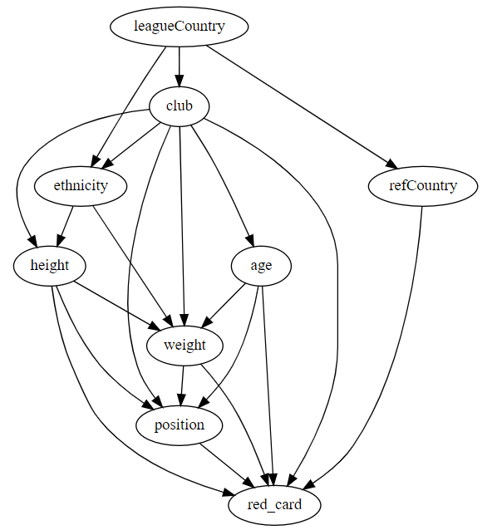
Assignment walkthrough
Creating the DAG
Football dataset
Proxy for ethnicity (skin tone)
Question: are players from different ethnicities more likely to get a red card?

Slide 31
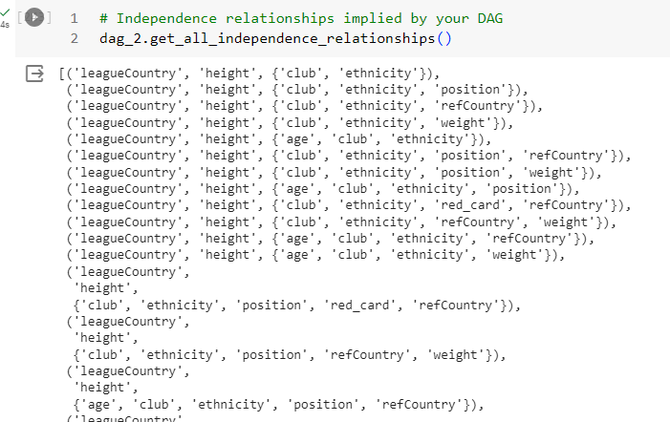
Assignment walkthrough
Independence relationships (testable assumptions)

Slide 32
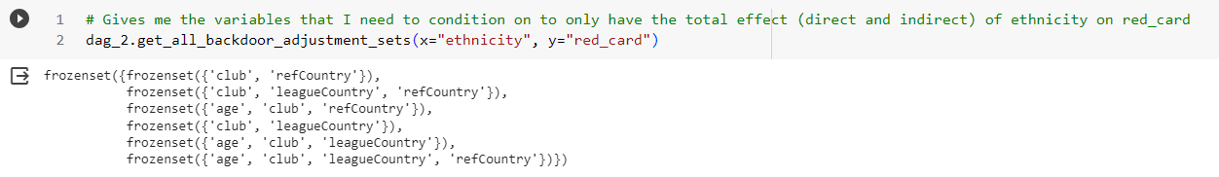






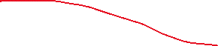

Assignment walkthrough
Getting the total effect

Slide 33
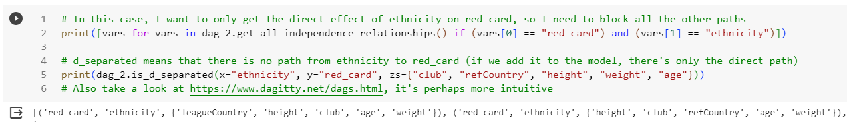
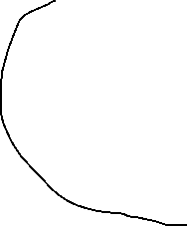
Assignment walkthrough
Getting the partial effect
There’s more than 1 possibility!
More testable assumptions

Slide 34
Assignment #1
colab.google (file that I sent you) or Github/Ordina-Group/20231130-data-science-hackathon
Split into teams of 3 or 4 people (pick the datasets that interest you the most)
Football dataset
Why do we see a difference in scores between different wines?
Is there discrimination in University admissions?
What causes people to have different moral judgments?
Is there unequal treatment in traffic stops?
Exercise 1 (only the causal inference part):
Create 1 or more DAGs with the variables you have available (for the questions you want to answer)
Create 1 or more DAGs with variables that might be missing from your dataset
Present your conclusions to the group
What the dataset is about
Data you have available
What conclusions you can get from the dataset (present DAGs you have)

Slide 35

Statistical inference
An introduction

Slide 36
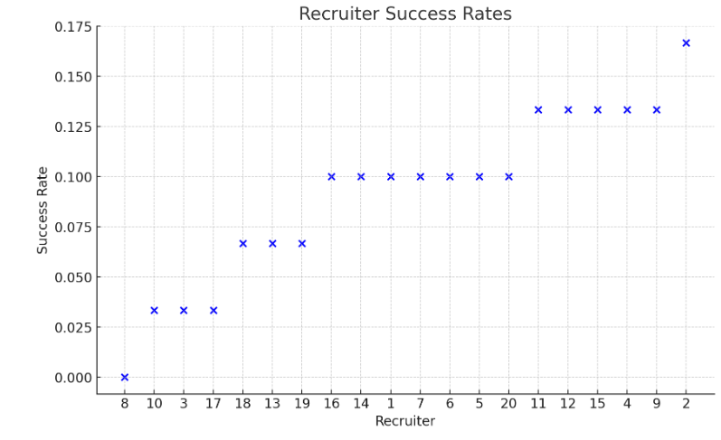
Why we care
Uncertainty is often crucial for decision making
There’s a cost to getting it wrong
Empirical data is always more variable than the “truth”
That’s why regularization works
If your sample size is large enough, you don’t need to worry much about it but…
…you almost never have enough data for what you want to measure
Noise, too many predictors, imbalanced classes, missing data, time series, etc.
Simulated example:
Each recruiter brings 30 candidates
Quality of recruiters/candidates is all the same (10%)

Slide 37
4 approaches for doing (pseudo-)statistical inference
Analytics
Visual representation of data & descriptive statistics
Frequentist
Statistical tests
Bayesian
Generative models
Data scientist
Model-agnostic methods (also with a focus on visuals)
Advice: always simulate to get a handle on whether you can trust a method for your case
See it as “test-driven development” applied to modelling

Slide 38
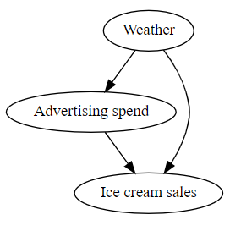
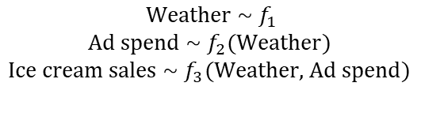
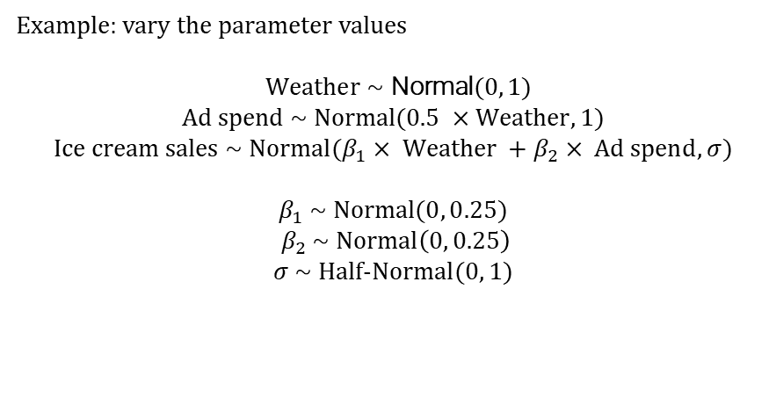
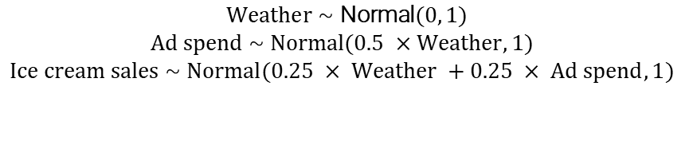
How to simulate data
(for problems that can be represented with DAGs)
Create a DAG
Represent it in mathematical form
Replace each function with probability distribution functions
(Optional) complexify it until it looks like the model you want to fit
$$\text{Weather} \text{\sim } f_{1}$$
$$\text{Ad} \text{spend} \text{\sim } f_{2}(\text{Weather})$$
$$\text{I}\text{ce} \text{cream} \text{sales} \text{\sim } f_{3}(\text{Weather}\text{, }\text{Ad} \text{spend})$$
Example: vary the parameter values
$$\text{Weather} \text{\sim } \text{Normal}(0, 1)$$
$$\text{Ad} \text{spend} \text{\sim } \text{Normal}(0.5 ×\text{Weather}, 1)$$
$$\text{I}\text{ce} \text{cream} \text{sales} \text{\sim } \text{Normal}(β_{1}× \text{Weather} +β_{2}× \text{Ad} \text{spend}, σ)$$
$$β_{1} \text{\sim } \text{Normal}(0, 0.25)$$
$$β_{2} \text{\sim } \text{Normal}\left(0, 0.25\right)$$
$$σ \text{\sim } \text{Half}\text{-}\text{Normal}(0, 1)$$
$$\text{Weather} \text{\sim } \text{Normal}(0, 1)$$
$$\text{Ad} \text{spend} \text{\sim } \text{Normal}(0.5 ×\text{Weather}, 1)$$
$$\text{I}\text{ce} \text{cream} \text{sales} \text{\sim } \text{Normal}(\text{0.25 }× \text{Weather} +\text{0.25 }× \text{Ad} \text{spend}, 1)$$

Slide 39
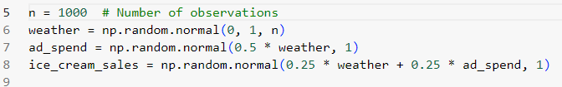

How to simulate data
(for problems that can be represented with DAGs)
In code form:
Question to answer: what’s the effect of ad spend on ice cream sales?
The truth: for every +1 in ad spend, we get +0.25 in ice cream sales
$$\text{Weather} \text{\sim } \text{Normal}(0, 1)$$
$$\text{Ad} \text{spend} \text{\sim } \text{Normal}(0.5 ×\text{Weather}, 1)$$
$$\text{I}\text{ce} \text{cream} \text{sales} \text{\sim } \text{Normal}(\text{0.25 }× \text{Weather} +\text{0.25 }× \text{Ad} \text{spend}, 1)$$

Slide 40
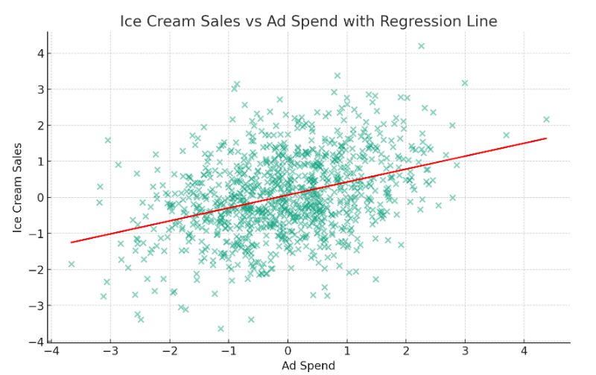
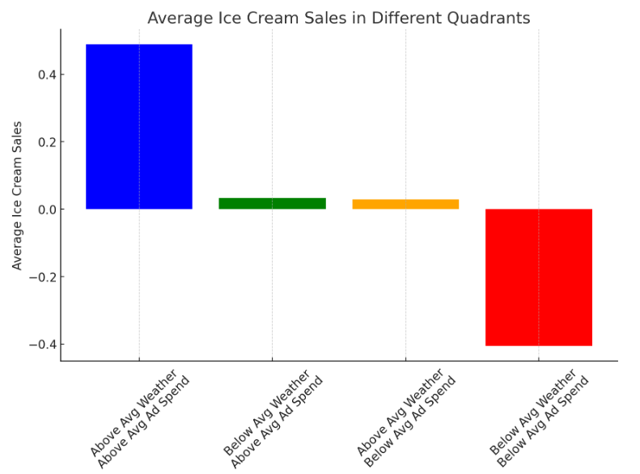
The analytics approach
Closer to pseudo-statistical inference
Say “insights” a lot
Make pretty graphs
“Slice and dice” the data
Use descriptive statistics
Conclusions you get:
Ad spend is positively correlated with sales (it’s not negative/zero!)
Ad spend is about as important as the weather (correct!)
But…
Biased effect (~0.5)
Very rough idea of the uncertainty
Wouldn’t deal with missing observations or many variables

Slide 41
It’s not as bad as you think
The larger the statistical effect, the less you need statistics for statistical effect to “show up”
(We will see an example of this in my walkthrough of Exercise 2)
You can create dashboards/visualizations really quickly (2 weeks?)
Thus…
It often detects the largest opportunities with the least amount of effort
But SHAP still beats it in pretty much every way

Slide 42
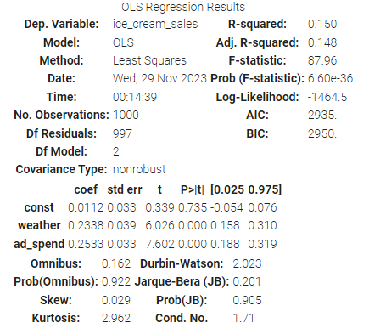

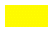

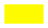
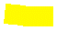
The frequentist approach
As it is often applied in practice
Say “significant” a lot
Show tables with many stars (“star gazing”)
Linear regression everywhere
Conclusions you get:
The correct effect size
The correct uncertainty
But…
This is not the uncertainty that you truly want to measure
Are the assumptions of the model met by the data?
Are we overfitting? (there’s no regularization)

Slide 43
The bear in the room: p-values
Roughly speaking, a p-value is a statistic that gives you the effect size divided by uncertainty.
Imagine we have a true/false test with n questions and k correct guesses. Null hypothesis is prob=50%. To get a p-value of ~1%:
9 correct out of 10 (90% success rate)
62 out of 100 (62% success rate)
537 out of 1000 (54% success rate)

Slide 44

The bear in the room: p-values
But what does a p-value of 1% mean?
Example: high-school student is given a high-school math exam with 10 true-false questions. They get 9 correct.
Some of the most common interpretations:
The result is significant (p<0.05) and therefore likely to be real
The probability that the student is above average is 99%
The probability that they’re not doing the test at random is 99%

Slide 45

The bear in the room: p-values
The tables turn…
But what does a p-value of 1% mean?
Example: 5-year-old student is given that same high-school math exam with 10 true-false questions. They get 9 correct.
The interpretation for the p-value should be the same. Is it?
The result is significant (p<0.05) and therefore likely to be real
The probability that the student is above average is 99%
The probability that they’re not doing the test at random is 99%
In both cases, all these interpretations are not correct

Slide 46
Frequentist statistics
What it is
It’s not synonymous with p-values or hypothesis testing.
“Probability” is the limit of the relative frequency of an event after a large number of trials.
Requires a repeatable experiment (in the abstract).
“Probability of an event/hypothesis/parameter” doesn’t make sense from a frequentist perspective.
The only type of uncertainty is sampling uncertainty
The p-value gives you:
“(…) the probability, under the null hypothesis, of observing a test statistic that is as large or larger than the one you have observed.”
- page 193, Probabilistic Machine Learning: an Introduction” by Kevin P. Murphy

Slide 47
Frequentist statistics
Some common mistakes
This sounds reasonable and correct:
“If the null hypothesis is true, this test statistic would probably not occur. This statistic did occur. Therefore, the null is probably false”
Translated:
“If the student is answering at random, this low p-value would probably not occur. This low p-value did occur. Therefore, the student is probably not answering at random.”

Slide 48
Frequentist statistics
Some common mistakes
This sounds reasonable and correct:
“If the null hypothesis is true, this test statistic would probably not occur. This statistic did occur. Therefore, the null is probably false”
Translated:
“If the student is answering at random, this low p-value would probably not occur. This low p-value did occur. Therefore, the student is probably not answering at random.”
Same logic:
“If a person is American, then they are probably not a member of Congress. This person is a member of Congress. Therefore, the person is probably not American.”

Slide 49
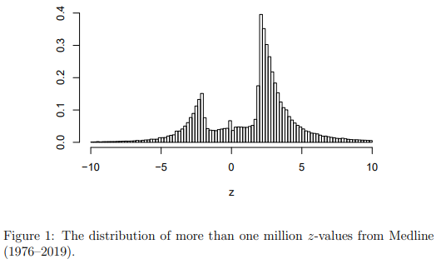
Frequentist statistics
Some common mistakes
“It’s significant”
When you say this, technical and less technical people think:
Significant = large effect (practically significant)
Significant = the effect is real; and “not significant” = the effect is basically 0
If you act when it’s significant = you can only be wrong 95% of times
And many other wrong things (read paper on 25 misinterpretations)
https://arxiv.org/pdf/2009.09440.pdf

Slide 50
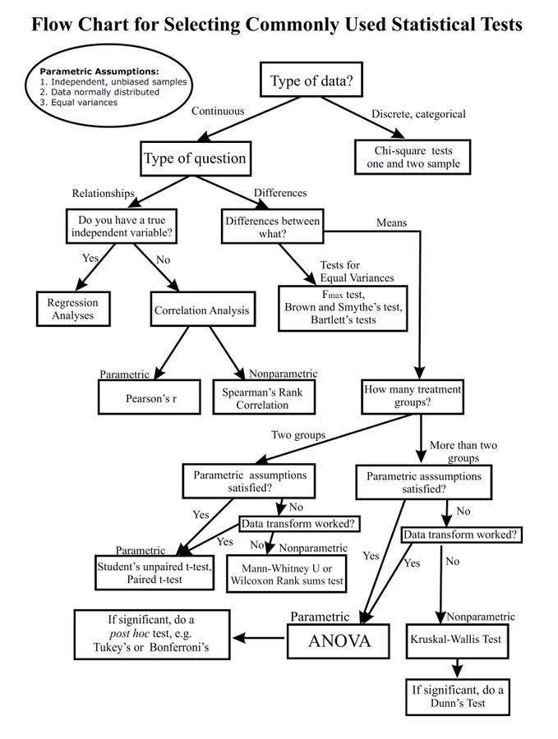
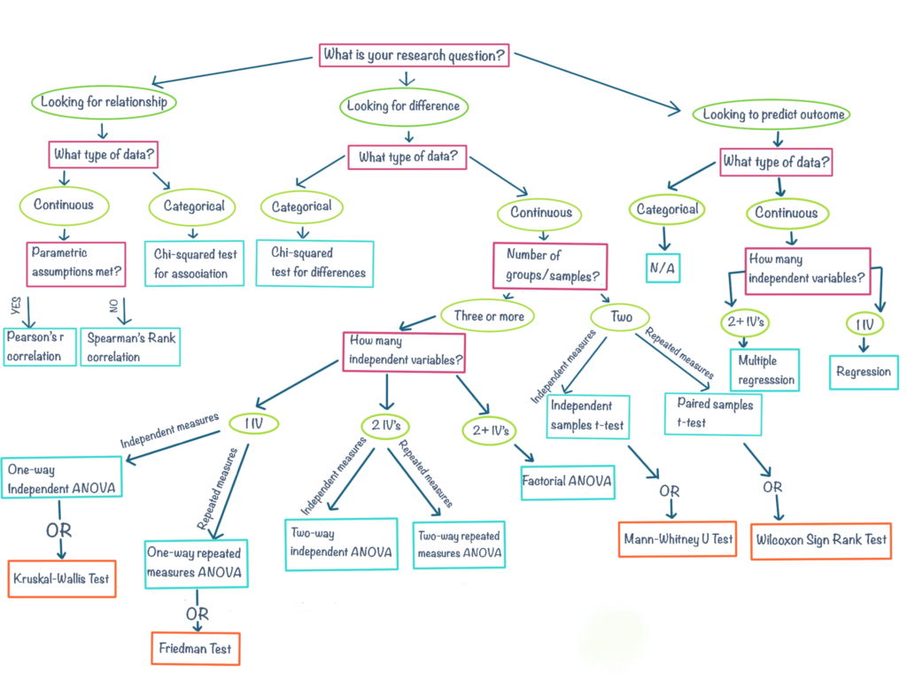
Frequentist statistics
Beware of the “statistical madness”
Each statistical test is essentially a model with its own assumptions
These checks are necessary if you want to do serious work

Slide 51
The Bayesian approach
As it is often applied in practice
Say “principled” a lot
Feel superior to frequentists because the theory is more applicable to real cases
Hierarchical models everywhere
There are also frequentist hierarchical models, but they’re much harder to fit
Differences:
Probability is a measure of uncertainty
Data, parameters, etc. all have probability distributions
Every model is (at least partially) generative
See the results of models as giving you a range of plausible values for your parameters for the data and assumptions you gave it (your “best guess”)

Slide 52
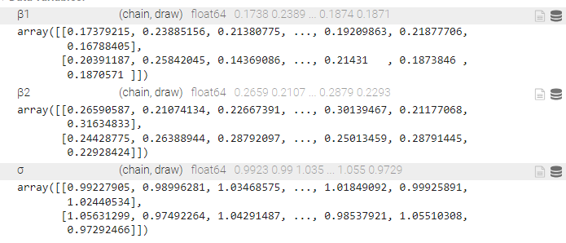
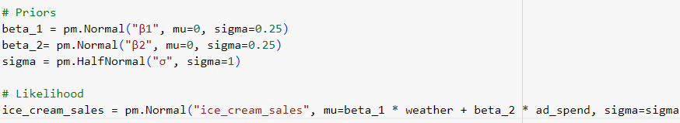
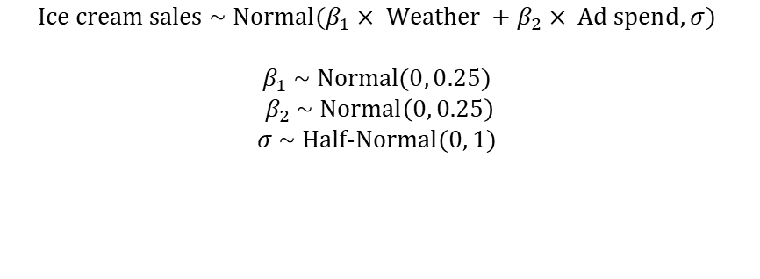
The Bayesian approach
Create a model
Likelihood (“shape of the data”, also used in frequentist models)
Priors
Fit the model
Extract the quantities of interest from samples of the posterior distribution
Disclaimer: “Bayesian models” in an ML context is a different thing
“full Bayes”: propagate uncertainty in the parameters
“ML Bayes”: uses some Bayesian principles/approximations to generate better predictions or outcome uncertainty
$$\text{I}\text{ce} \text{cream} \text{sales} \text{\sim } \text{Normal}(β_{1}× \text{Weather} +β_{2}× \text{Ad} \text{spend}, σ)$$
$$β_{1} \text{\sim } \text{Normal}(0, 0.25)$$
$$β_{2} \text{\sim } \text{Normal}\left(0, 0.25\right)$$
$$σ \text{\sim } \text{Half}\text{-}\text{Normal}(0, 1)$$

Slide 53
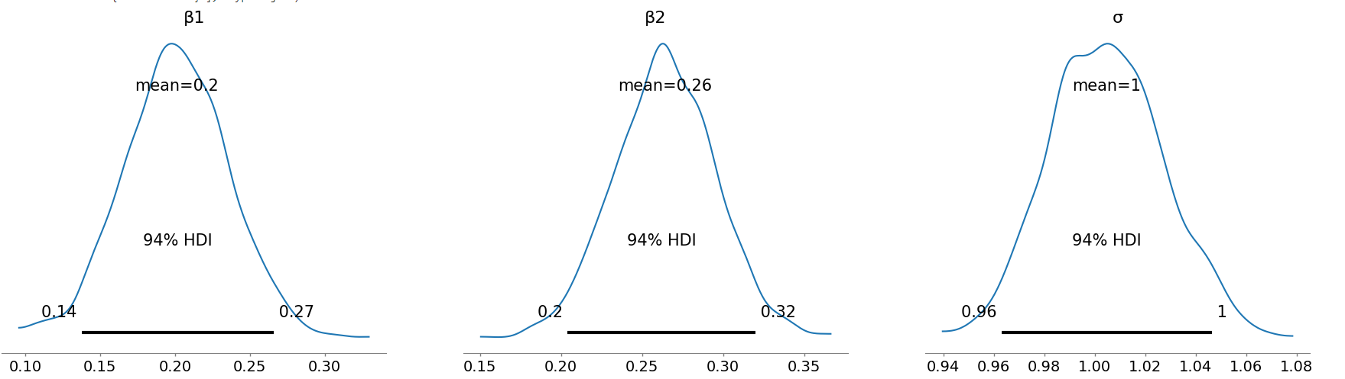
The Bayesian approach

Slide 54


When the prior is “flat”
Results are then identical to frequentist ones

Slide 55

How different priors affect the posterior
Holding the data fixed (likelihood is always the same)

Slide 56


The Bayesian approach
Applied to the 5-year-old student example
High-school student: wide prior, assume that most students are somewhere around 50%
5-year-old student: extremely narrow prior, assume that there’s almost 0 chance of not being
Result: We would need a lot more evidence for the 5-year-old
Prior for the high-school student
Prior for the 5-year-old student

Slide 57


Why we care about adding priors in practice
Easier to fit certain classes of models (missing data, “imbalanced classes” or low n in general, p > n)
Propagates the uncertainty in a correct way
A lot more flexibility because you generally don’t need analytic solutions or bootstrapping as in frequentist models
Some of the algorithms used are more robust & comes with diagnostics when model assumptions are not good
Hamiltonian Monte Carlo
(“explores”, used for training Bayesian models)
Gradient descent
(optimizes)

Slide 58
When to (not) use Bayesian models
Excellent when you have smaller sample sizes, imbalanced datasets, p>n, etc.
Excellent if you need to calculate “what-if” scenarios (simulation)
Issues
Models can be really hard to fit — “exploration” is hard when there is, e.g., multimodality (folk theorem of statistical computing)
You can use non-HMC algorithms if you have large datasets, but a lot of the advantages vanish (similar to fitting typical neural networks)

Slide 59


The Data scientist approach
As it is often applied in practice
Say “explainable” a lot
Make pretty graphs
Mess with data as if they’re doing prediction (don’t do this!)
Up-/down-sampling (or data augmentation)
Filling missing values with whatever
Remove outliers “because it predicts better”
Remove multicollinear inputs (again, “because it predicts better”)
Shapley values don’t work — refits the model with different coalitions (groups) of variables
SHAP values do work (it’s based on Shapely values but apparently not a proper approximation)
But their results are a bit more variable, uncertainty is probably underestimated
Disclaimer: only tested it with the TreeExplainer using tree models; I didn’t review the academic literature on this

Slide 60


How to interpret shap values
X:
Effect on y:
These plot the conditional relationship and uncertainty

Slide 61

Meta learners
It’s nothing new
Estimates the Conditional Average Treatment Effect (there’s no uncertainty unless you bootstrap)
It’s doing the same thing that we’ve been doing, but with a black box model rather than an interpretable one
Issue: many ML models are not good at extrapolation (~everything is extrapolation when p -> +inf).
It’s better to only use this if T is categorical.
Be careful about using something other than the S-learner
Keeping everything in a single model, when possible
https://matheusfacure.github.io/python-causality-handbook/21-Meta-Learners.html

Slide 62
Assignment #2
Exercise 2 (statistical inference part):
Fit the models with the inputs that you thought you needed from your DAGs (start with )
Present your conclusions to the group
How the results vary between methods or between different variables
The conclusions you think you can make

Slide 63

Applicability
in industry
A discussion

Slide 64

How objective are we, really?
Causal inference: variables that researchers picked for the football example
Study that gave the same dataset to many researchers. Here are the inputs that they picked.
https://journals.sagepub.com/doi/10.1177/2515245917747646

Slide 65

How objective are we, really?
Statistical inference: methods that researchers picked for the football example

Slide 66

Challenges
Causal inference
Conceptual issues (e.g., direction of causal effect)
Many things that we didn’t consider (most are not fixed by SHAP)
Missing observations (it’s a causal inference problem!)
Almost everything is a proxy/descendant (uncertainty is understated)
There are probably hidden cofounders everywhere
Time-varying effects
Feedback loops & network effects
Heterogeneous effects (with multiple hypothesis correction)
Hard to test assumptions in practice
Statistical inference
All the problems associated with prediction, plus…
Requires a good amount of expertise & careful (slow) work
We don’t have enough computational power to solve every problem in the best way
You’ll often be competing against pretty dashboards & slides (SHAP is a good weapon against it)
If you must do this, in practice, your best bet is to create synthetic data to understand what the method is doing.

Slide 67

A more informed opinion
Use causal inference to understand how to create (pseudo-)random experiments
Video

Slide 68
Your opinion?

Slide 69
Main sources & additional resources
“Statical Rethinking” by Richard McElreath – awesome book & course on causal/statistical inference & philosophy of science
“Probabilistic Machine Learning: An Introduction” by Kevin P. Murphy — ML taught more intuitively (Bayesian perspective)
“Probabilistic Machine Learning: Advanced Topics” by Kevin P. Murphy
Bonus: “Why Propensity Scores Should Not Be Used for Matching” video — if you want to know more about matching
Bonus: Probable Causation podcast — academic podcast (social science), researchers get creative when trying to identify causal effects
Bonus: check the links in the other slides

